Slide 1
ContactApp - Full Stack Contact Management System
A comprehensive full-stack solution built with Spring Boot, React, and MongoDB for seamless contact management and real-time search capabilities.

Slide 2



Project Overview & System Architecture
ContactApp is a full-stack CRUD application designed for efficient contact management with real-time search and responsive design capabilities.
React Frontend
Spring Boot API
MongoDB Database
Port 3000
Port 8080
Port 27017
User interface with real-time updates and responsive design
RESTful services handling business logic and data operations
NoSQL storage for flexible contact data management

Slide 3
Complete Technology Stack
Backend Technologies
Frontend Technologies
Database Technology
Spring Boot 3.5.5
React 19.1.1
MongoDB (NoSQL)
Java 17
Axios for HTTP requests
JSON document format
Maven build tool
JavaScript ES6+
Flexible schema design
Spring Data MongoDB
CSS3 styling
High-performance queries
Spring Web framework
NPM package manager
Scalable data storage
Embedded Tomcat server
Component-based architecture
REST API architecture

Slide 4

Project Structure & MVC Pattern
Backend (Spring Boot)
Frontend (React)
Model Layer
Main Component
User.java - Defines the data structure and entity mapping for contact information
App.js - Core application logic, state management, and API integration
Styling
Repository Layer
App.css - Custom styles for responsive and modern UI design
UserRepository.java - Handles database operations and custom queries
The MVC pattern ensures clean separation of concerns, making the application maintainable, scalable, and easy to test.
Controller Layer
UserController.java - Exposes REST API endpoints for client communication
Configuration
application.properties - Database connection and application settings

Slide 5



Key Features & Functionality
Add Contact
View All Contacts
Edit Contact
Form validation ensures data integrity during contact creation with real-time error handling
Display comprehensive contact list with clean, organized layout and instant loading
Update existing contact data seamlessly with pre-populated forms and validation
Delete Contact
Real-time Search
Responsive UI
Safely remove contacts from the database with confirmation prompts
Filter contacts instantly by name, email, or phone number without server calls
Clean, user-friendly interface that adapts beautifully to all screen sizes

Slide 6






REST API Endpoints & HTTP Methods
The application exposes a comprehensive RESTful API supporting full CRUD operations with search capabilities.
GET /contact/users
Fetch all contacts from the database
POST /contact/users
Create a new contact with validation
GET /contact/users/{id}
Retrieve specific contact by unique ID
PUT /contact/users/{id}
Update existing contact information
DELETE /contact/users/{id}
Remove contact from the database
GET /contact/users/search/{keyword}
Search contacts by name, email, or phone
CRUD Operations: Create, Read, Update, and Delete - the foundation of data management

Slide 7

Spring Boot Implementation Details
Key Annotations
Database Integration
@SpringBootApplication - Main application class bootstrapping
Spring Data MongoDB provides powerful repository abstraction with built-in CRUD operations and custom query methods.
@RestController - Marks REST API endpoint classes
@Autowired - Enables dependency injection
MongoRepository Interface: Extends CrudRepository to provide standard database operations without writing implementation code
@Document(collection="users") - Maps entity to MongoDB collection
@GetMapping - Handles HTTP GET requests
@PostMapping - Handles HTTP POST requests
Custom Search Methods: findByNameContainingIgnoreCase enables case-insensitive partial matching for flexible search functionality
@PutMapping - Handles HTTP PUT requests
@DeleteMapping - Handles HTTP DELETE requests

Slide 8




React Frontend Implementation
useState Hook
useEffect Hook
Manages application state including users list, form data, and editing state for dynamic UI updates
Handles component lifecycle events, triggering API calls on mount and updates
Axios Integration
Event Handlers
Provides clean API communication with GET, POST, PUT, and DELETE methods for seamless backend interaction
Manages form submission, user actions, and real-time input validation
Advanced Frontend Features
Real-time Filtering: Client-side search without API calls for instant results and reduced server load
Form Validation: Comprehensive error handling ensures data quality before submission
Dynamic UI Updates: Automatic re-rendering when data changes for smooth user experience

Slide 9

Application Flow & Data Integration
Initial Load
React app loads and useEffect automatically triggers API call to fetch all contacts
Backend Processing
Spring Boot receives request, and Repository queries MongoDB for contact data
Data Transfer
Contact data returns as JSON format, ensuring seamless communication between layers
UI Update
React updates the user interface with retrieved data, displaying contacts dynamically
User Actions
User interactions trigger new API calls, database updates, and automatic UI refresh with latest data
MongoDB Integration: Connection configured via application.properties with document-based storage offering flexible schema and automatic JSON conversion

Slide 10
Demo & Learning Outcomes
Live Demonstration
Browse complete contact list with sorting capabilities
Add new contacts with form validation
Edit and update existing contact information
Delete contacts with confirmation dialogs
Real-time search functionality across all fields
Responsive design on desktop, tablet, and mobile screens
Key Skills Demonstrated
Full-Stack Development
REST API Design
Integration of frontend, backend, and database layers into cohesive application
Professional API implementation following industry best practices and conventions
Modern Web Technologies
MVC Architecture
Expertise in React, Spring Boot, and MongoDB with latest features and patterns
Clean separation of concerns ensuring maintainable and scalable codebase

Slide 11
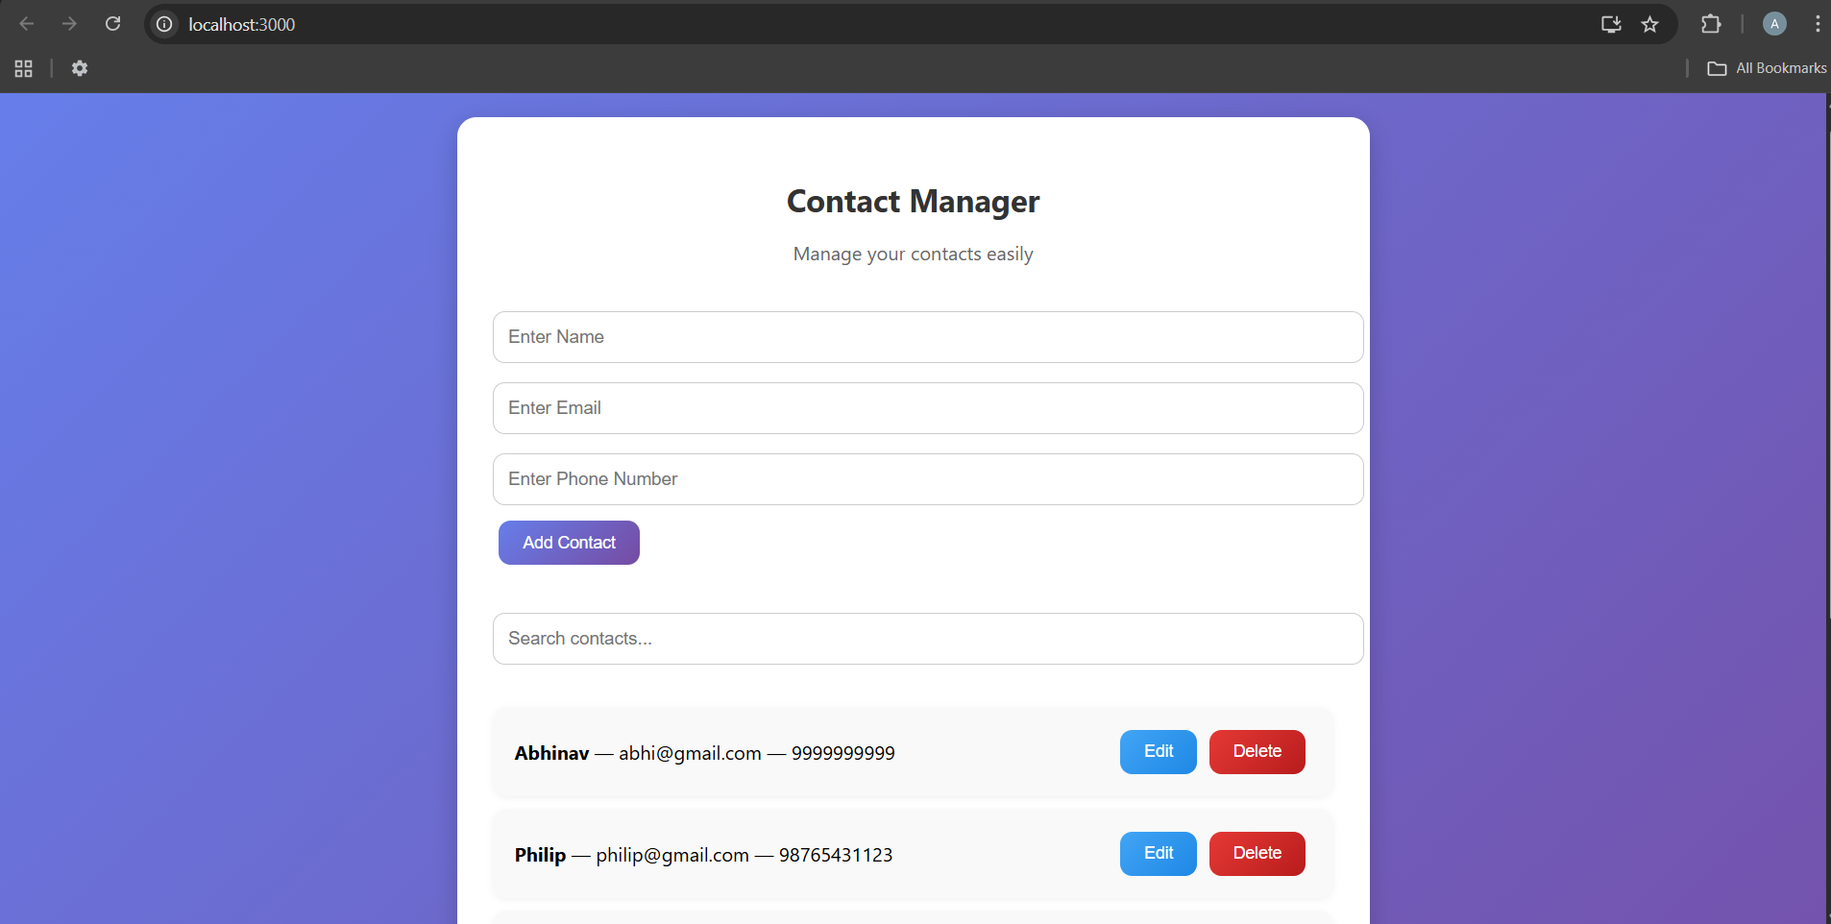
Sample Output
Frontend: React

Slide 12
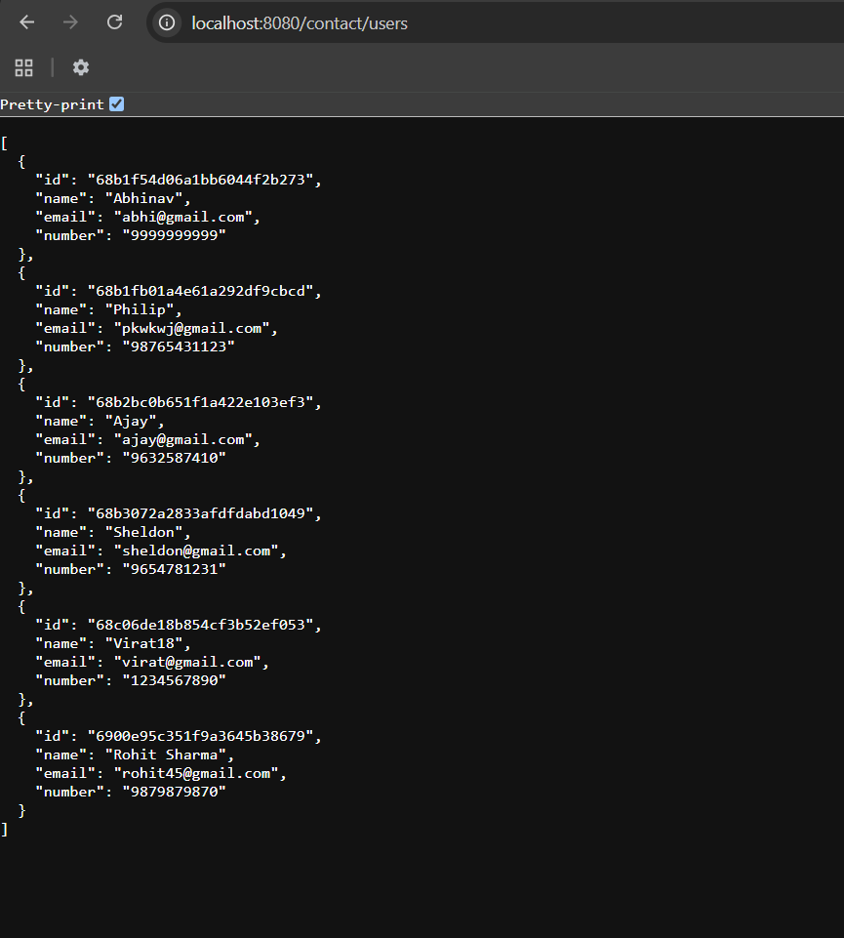
Backend: SpringBoot

Slide 13
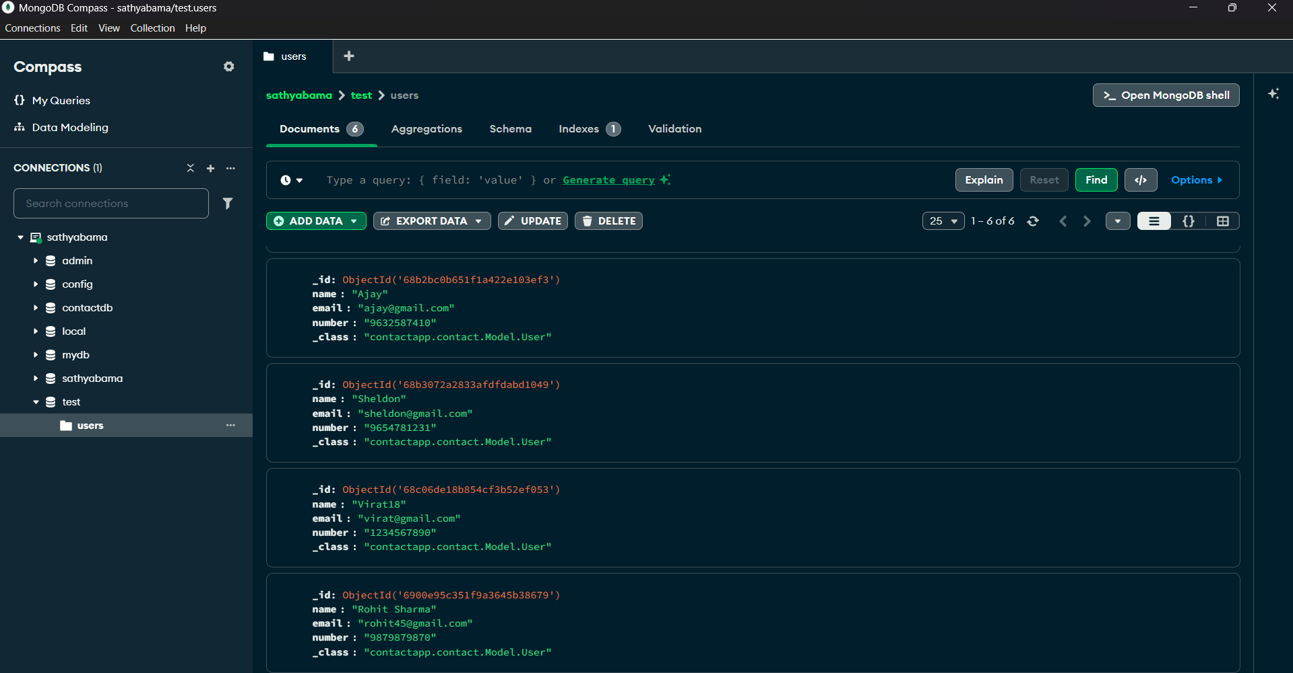
Database: MongoDB

